Slide 1

{ Feel free to insert images here or delete }
N315 – Project One
Jake Terry
09/25

Slide 2
Discussion 1
The goal is to create a vampire survivors/brotato like game where enemies swarm you and the goal is to survive, all the while you search for pick-ups that assist you.
Players will have a default weapon that is reliable with infinite ammo but weak.
Better weapons will be scattered around the map to encourage players to search for them.
Enemies will spawn off screen and track towards the player.

Slide 3
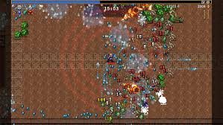
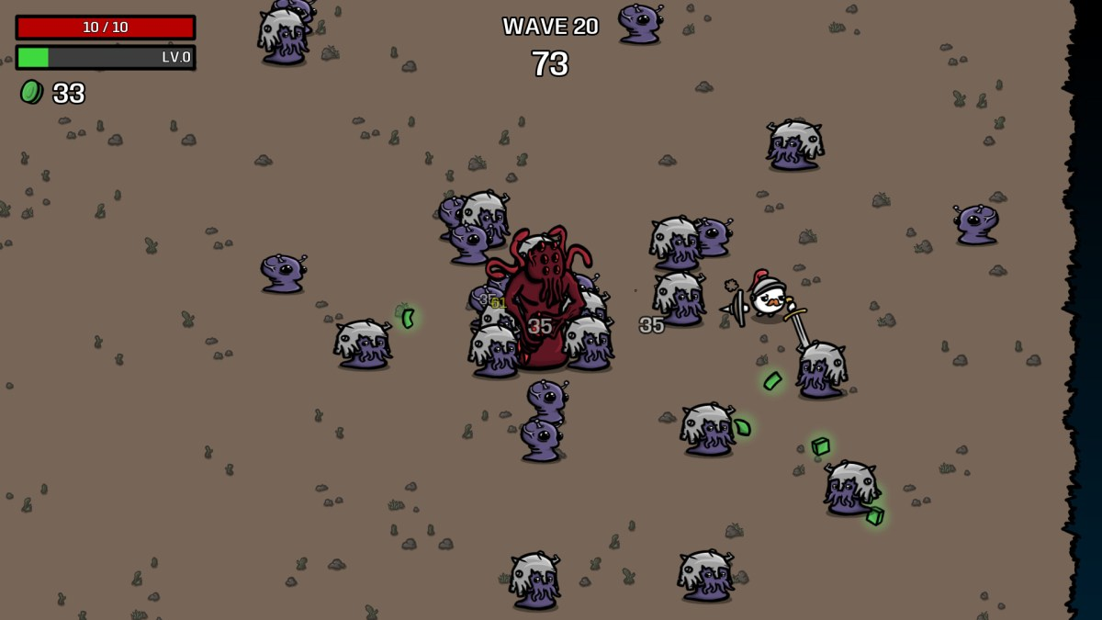
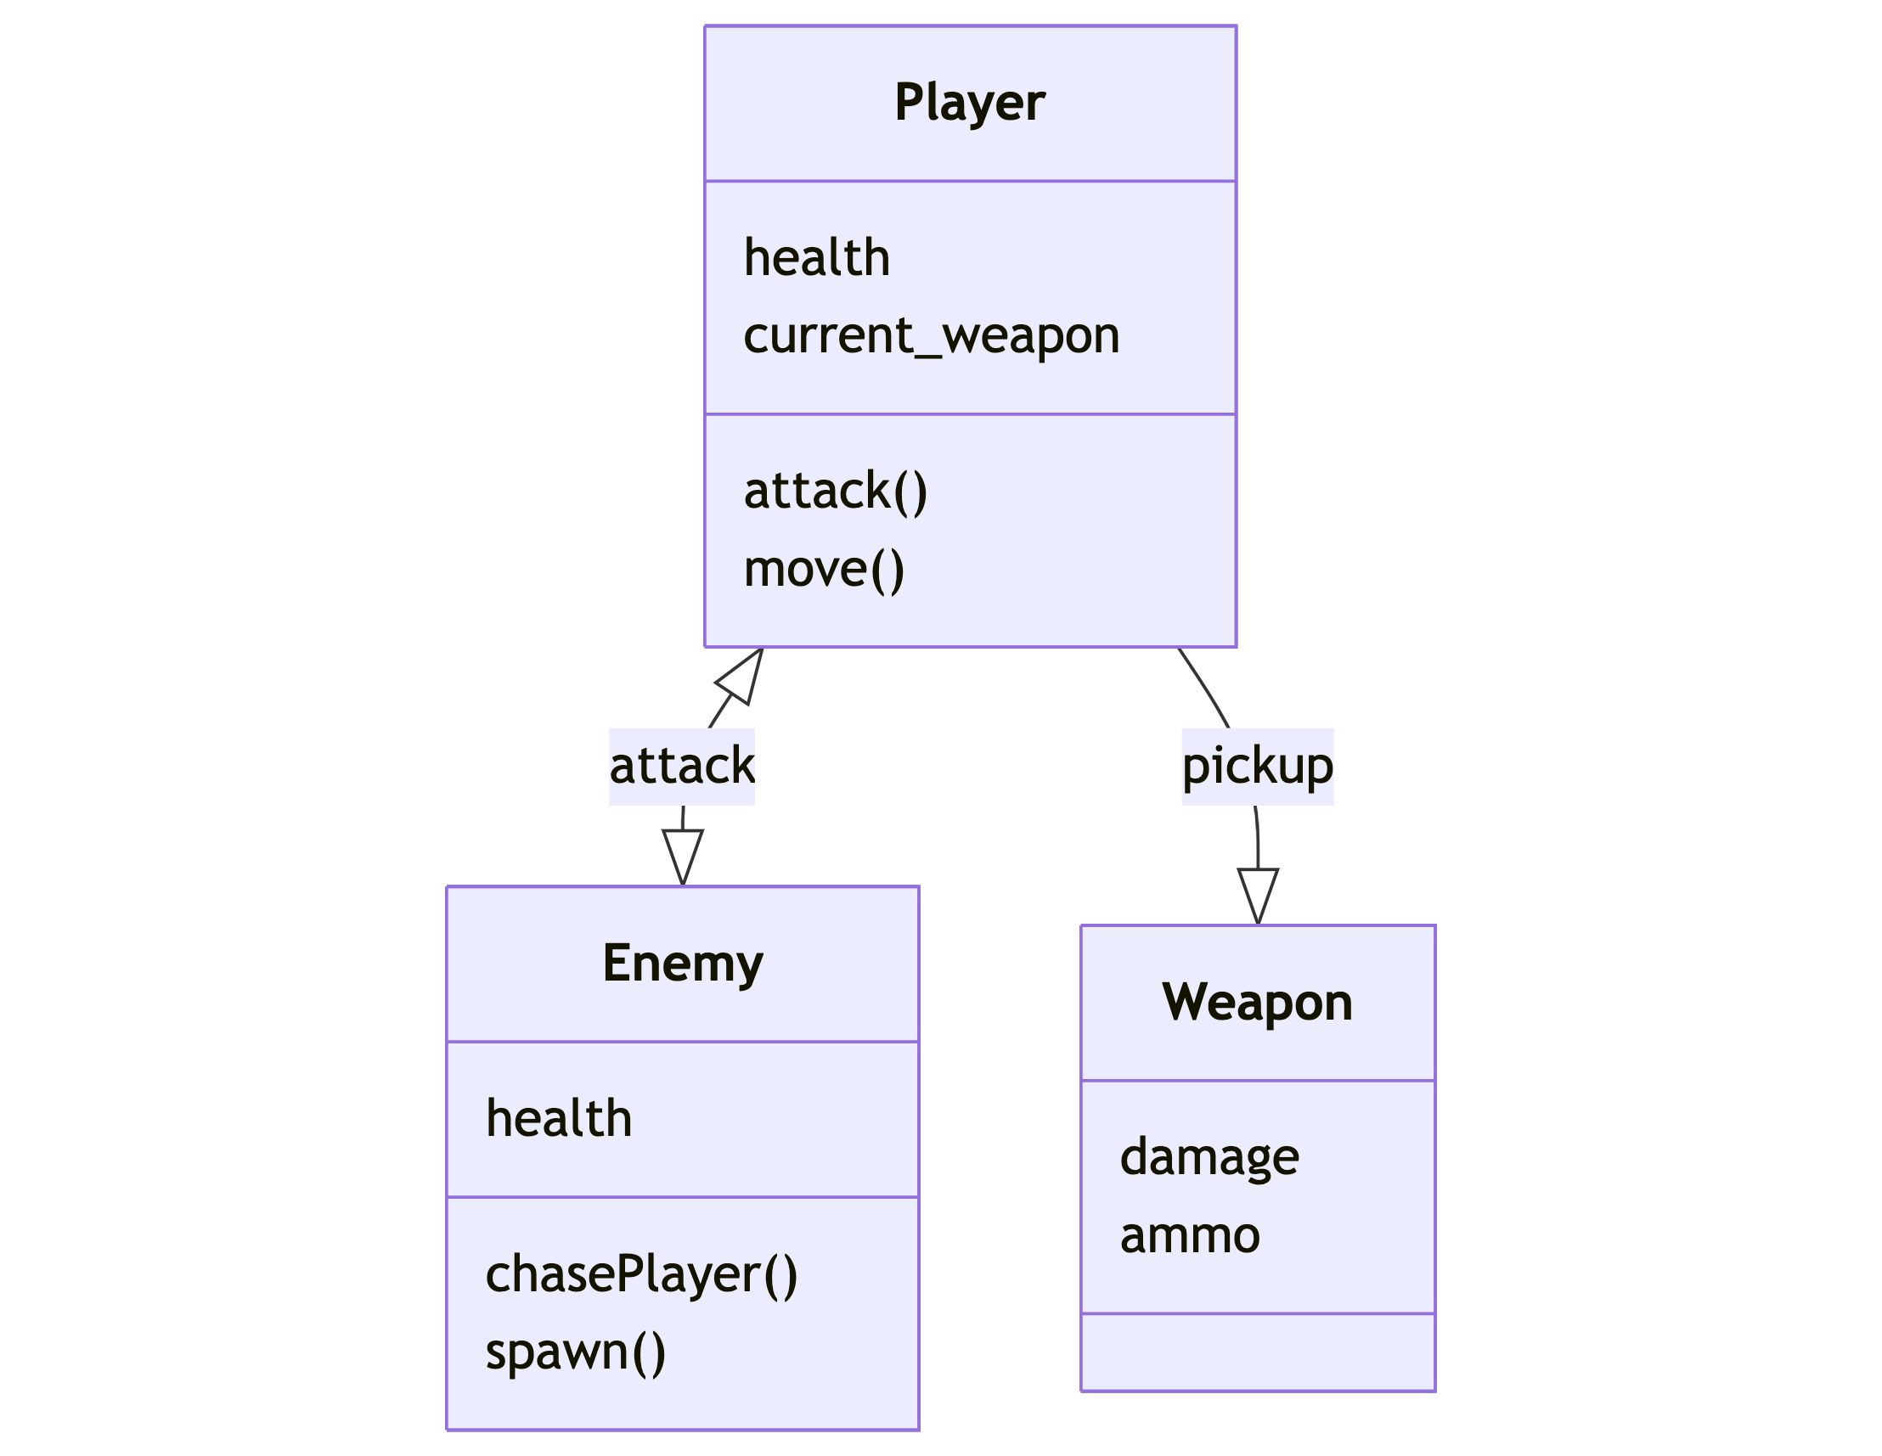
Discussion 1 – Screenshot / image

Slide 4
Discussion 1 – Question
What is something you are struggling with in your game?
I need to think of a good name for the game.
I will need to figure out how to spawn enemies off screen but not so far from the player that it takes a long time to show up.
I need to figure out pathing around obstacles for enemies.
I need to plan out power-ups/different weapons for the player.

Slide 5
Discussion 1
Have a peer / group look through your code and comment on
File structure
Commenting / algorithm planning
Repetitiveness
Readability
Succinctness

Slide 6
Discussion 1
Delete this and add 2-3 takeaways from your discussion with your peer
Learned X
Decided Y would be important to focus on next
Focus on coding principles:
Commenting, indentation, good variable names, general structure

Slide 7
Discussion 1 –Reflection
Delete and add your own reflection on:
Unknowns about Godot
New resources found
What you tried that didn’t work – and how you’re going to try something new

Slide 8
Discussion 1 –Self Assessment
Bold your self-assessment on the following areas
Project progress poor acceptable excellent
Variable naming poor acceptable excellent
Debugging / problem solving poor acceptable excellent
Godot exploration poor acceptable excellent
Polish plans poor acceptable excellent

Slide 9
Discussion 2

Slide 10
Discussion 2 – Screenshot / Image

Slide 11
Discussion 2 - Question
What is something you are struggling with in this project?

Slide 12
Discussion 2 -
Delete and replace with summary bullet points about the aesthetics of your game:
Balance
Emphasis
Movement

Slide 13
Discussion 2 –Reflection
Delete and add your own reflection on
How you are learning to “structure” your project so it is maintainable long term
Your approaches and strategies to messaging between objects in Godot

Slide 14
Discussion 2 – Self Asssessment
Bold your self-assessment on the following areas
Project progress poor acceptable excellent
Variable naming poor acceptable excellent
Debugging / problem solving poor acceptable excellent
Godot exploration poor acceptable excellent
Polish plans poor acceptable excellent

Slide 15
P1 – Final Reflection
Screenshot of final product here

Slide 16
P1 – Final Reflection
Delete and add 5-ish bullet points about your project. Cover at least one of each below
Technique
Use some of these words: variables, code blocks, conditions, control flow, algorithm, planning, files, readability, debugging
Aesthetics
Use some of these words: reactive, eye-catching, guiding, alert, joyful, unintended, contrast, similarity, flow
Major concepts learned

